Slide 1

Welcome to NTEU
What can we do for you?
Notes:
Introduce yourself and any chapter leaders in attendance and consider sharing your story of why you joined the union and then decided to become a chapter leader.
Today, we are going to give you an introduction into NTEU and unions more generally. We are going to start with some basics and then move into our union movement and why we want you to be a part of it.

Slide 2
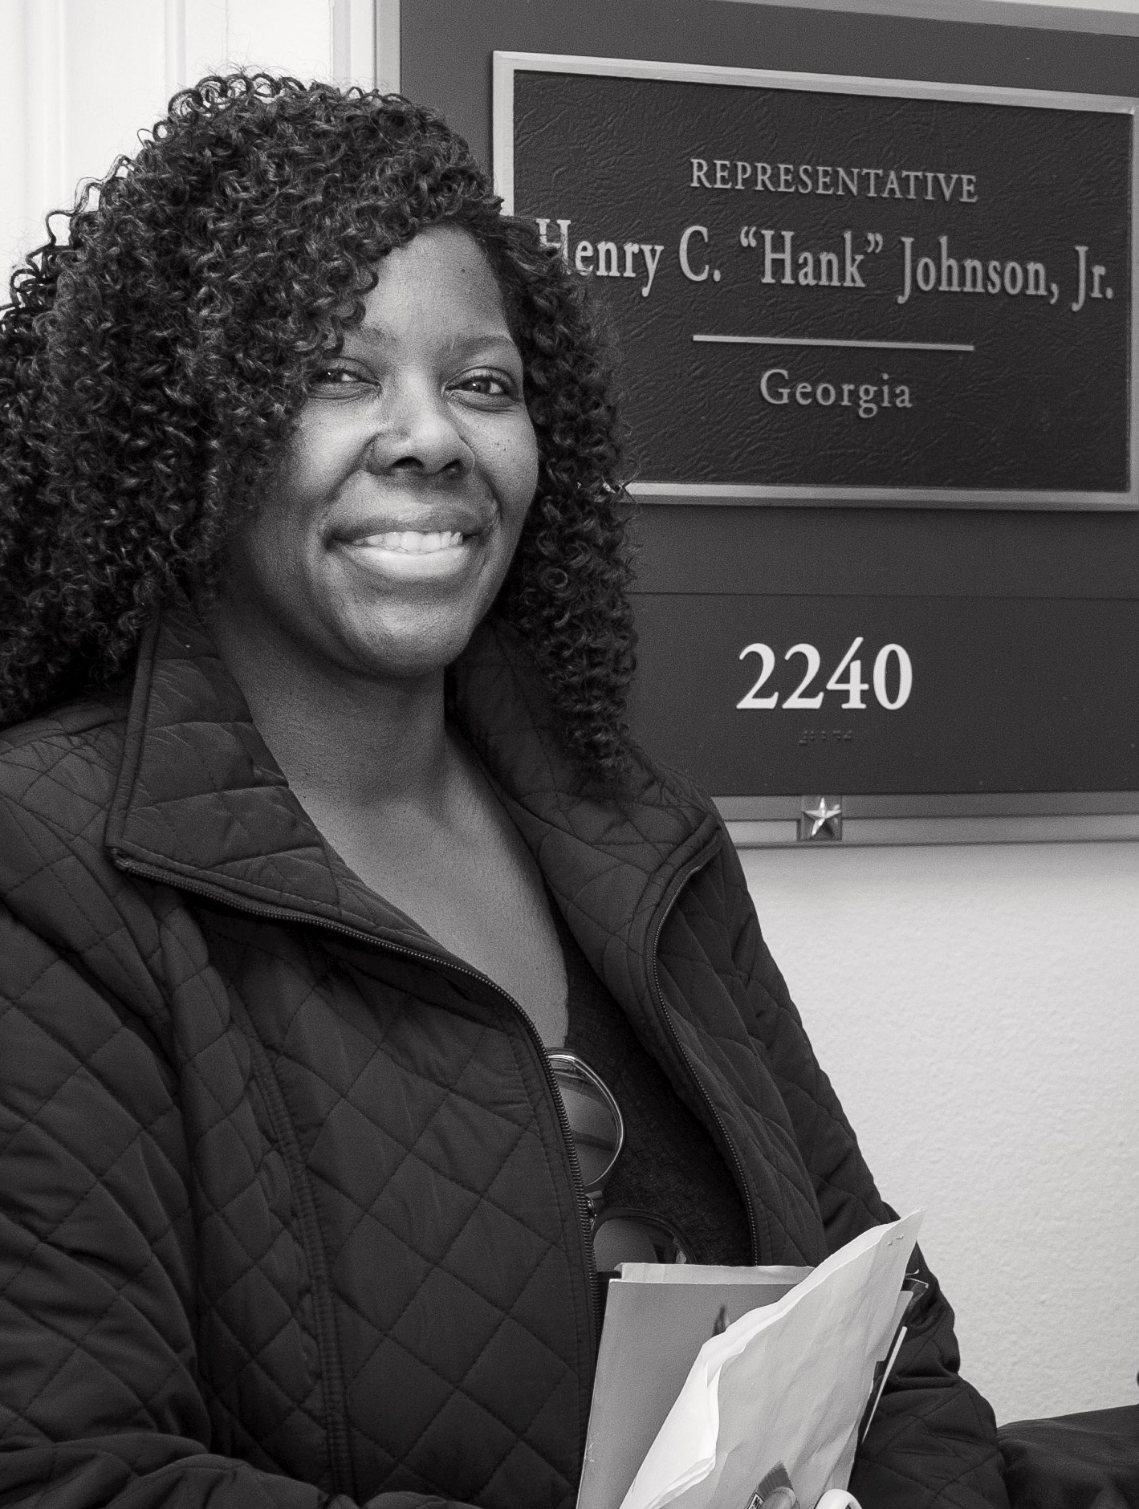
What is a Union?
Unions help create a more stable, productive and equitable workplace.
Your union—NTEU—works at the bargaining table, on Capitol Hill and in the courts to ensure you have fair pay, benefits and workplace rights.
With NTEU, you have a voice in workplace decisions that impact you.
Notes:
Our union is a progressive organization that believes in good government and fights for the rights of every federal employee. We are part of the movement that ended child labor and created the weekend.
NTEU, your union, has delivered many of the programs, benefits and rights you value in your workplace. With your support, we can protect these gains and deliver more.

Slide 3

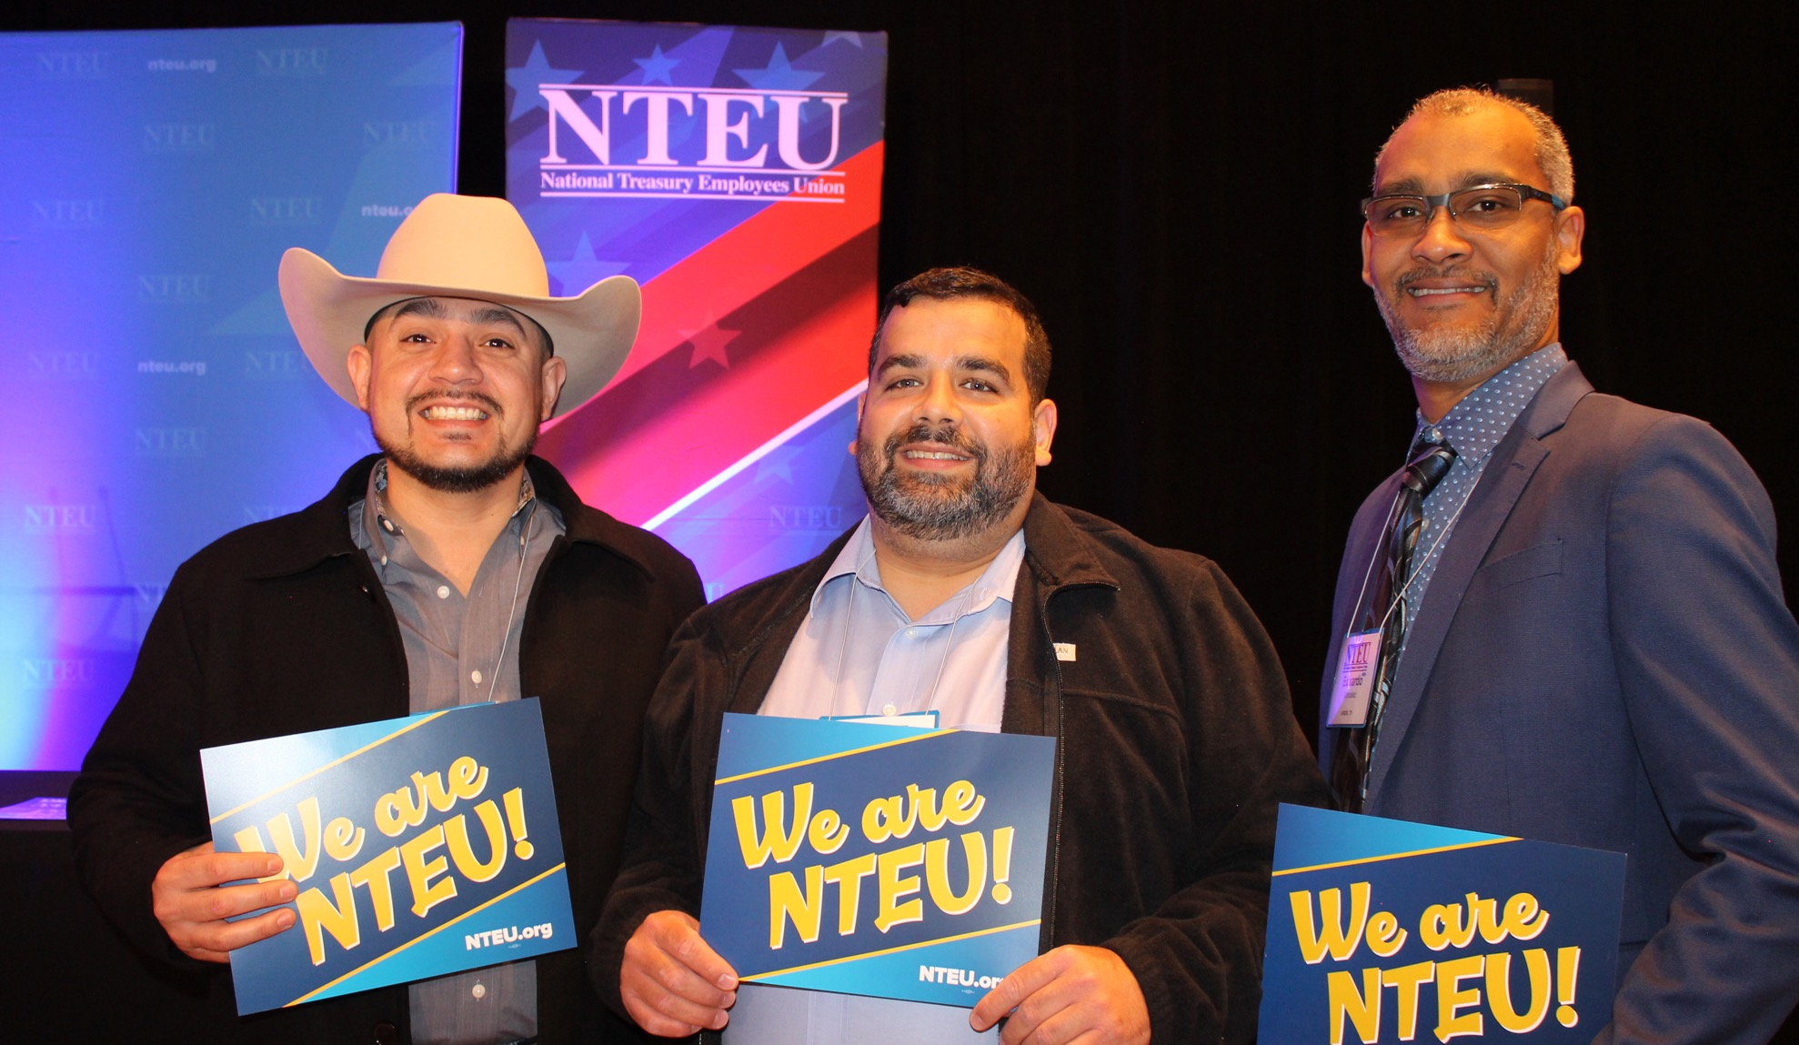
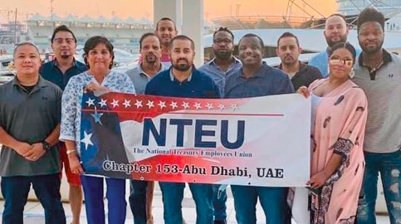
WHY DO WE HAVE A UNION?
Your colleagues wanted a union to represent them with management; AND
They wanted NTEU to be their union.
Notes:
NTEU is our union because your colleagues voted for union representation and then voted for NTEU to be their union. They wanted a strong advocate to help improve the workplace and make sure they have the tools and resources to do the job. Together, we have a greater voice to make positive changes in the workplace.

Slide 4
WHY JOIN A UNION?
It is tough for one employee to convince all of Congress to provide federal
workers with a higher pay raise or establish a new benefit like paid parental leave.
Notes:
There is power in numbers. The more support we have, the more we can win on our behalf. The benefits and programs that attracted you to your job were won by NTEU members before you who supported our union through their membership.
Unions improve the well-being of you and your colleagues and support our agency mission– by improving job security and benefits, strengthening labor-management partnerships and advocating for safer, fairer and more equitable workplaces.

Slide 5
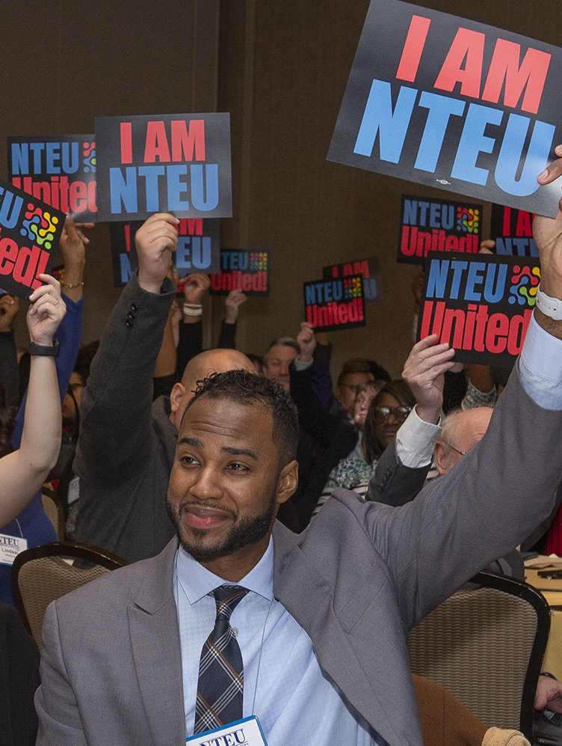
SOLIDARITY
IS POWER
But it’s hard to ignore the collective voices of a large group of employees calling for positive change.
And that is exactly what a union does.
And NTEU is pretty darn good at it.
Notes:
Remember: Management doesn’t just hand over workplace benefits and programs
As individuals, we don’t have much power, but as a collective we can demand better and WIN!

Slide 6
AM I AUTOMATICALLY A MEMBER OF NTEU?
NO!
As a bargaining unit employee, you are represented by NTEU
BUT if you want a say in the issues NTEU tackles at the bargaining table and in Congress, you need to become a member.
Don’t be silent!
Join NTEU by completing a SF-1187 or online at nteu.org/join
Notes:
The union represents all bargaining unit (non-management) employees.
As a bargaining unit employee, you are eligible to join NTEU but not automatically a member.
To become a member, you must sign our membership form, which is fully electronic, secure and can be completed from anywhere.

Slide 7
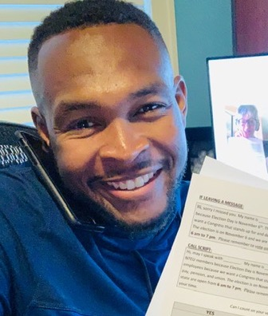
Why should
I care?
Notes:
Telework programs, alternative work schedules, paid parental leave, transit subsidies and many others program and benefits were not handed to us by congress or agency management. NTEU fought for these and we won.
All of those things you value are at risk without a strong union—and a union is only as strong as its membership.

Slide 8
Congress controls your pay and benefits.
All of the hallmarks of a “good government job” exist because of unions.
Being part of NTEU gives you a say in the union’s priorities and the issues we will fight for on your behalf.
Notes:
-You cannot just sit back and expect that your rights will always exist. They exist because of a strong union in your workplace. We need your support to continue to be strong and effective. And, you can have a say in what we fight for.

Slide 9
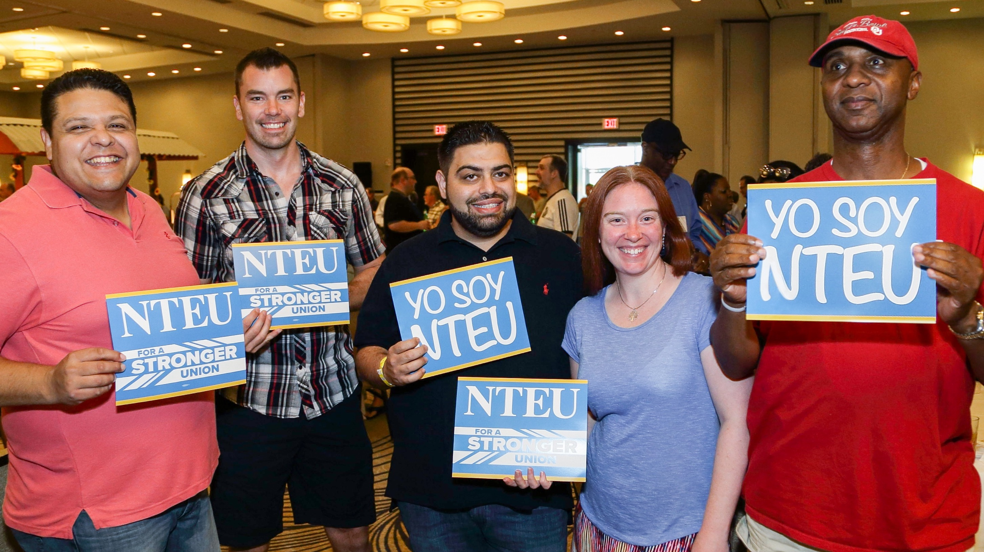

Slide 10
What does NTEU do?
We negotiate the most innovative contracts in the federal government.
We advocate for fair pay, benefits, agency funding and workplace rights on Capitol Hill.
We win legal battles resulting in higher overtime rates, millions in back pay and expanded rights.
We keep you informed of breaking news and information you need to navigate work.
We save you money on insurance, tax preparation, travel, professional services and more.
We are in the workplace to answer questions, solve problems and provide advice.

Slide 11
Where do my union dues go?
Contribute directly to the strength of your Chapter
Do not go to political candidates
Amount is based on your current pay
GS 9: $30/month
Notes:
-Union members pay union dues. That funds our ability to do what we do. Without union dues, there is no union.
-Dues go both to the local chapter and NTEU National.
-NO dues money is used for political purposes, like campaign donations. While NTEU does have a political arm, that is funded solely through voluntary contributions.

Slide 12
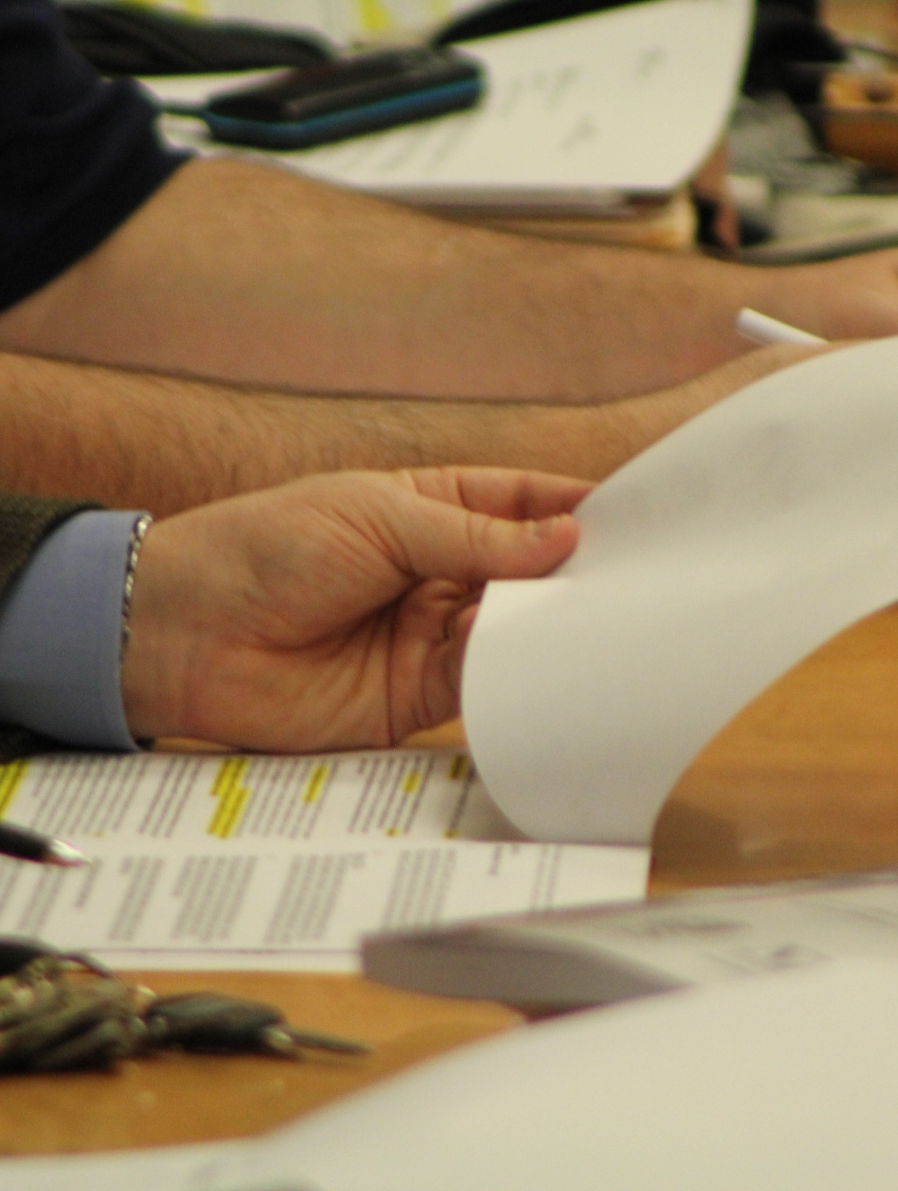
What is “the contract?”
Contract = your collective bargaining agreement (CBA)
Details your defined rights and benefits on everything from leave to promotions to work schedules
Notes:
-You do not have these rights because management wanted to give them to you.
-You have these rights because unions fought for these for years! Unions raised and pushed the issue of telework and have for years. The fact that telework is common across the federal government now often dilutes the fact that it exists because of us!

Slide 13
Your contract is the most important document in your working life.
Notes:
One of the most important things your union does is negotiating your contract. It provides for the workplace programs, benefits and protections mentioned earlier. It also creates a fair process for resolving workplace disputes, which can happen to anyone. It holds management accountable and ensures everyone has equal opportunities.

Slide 14
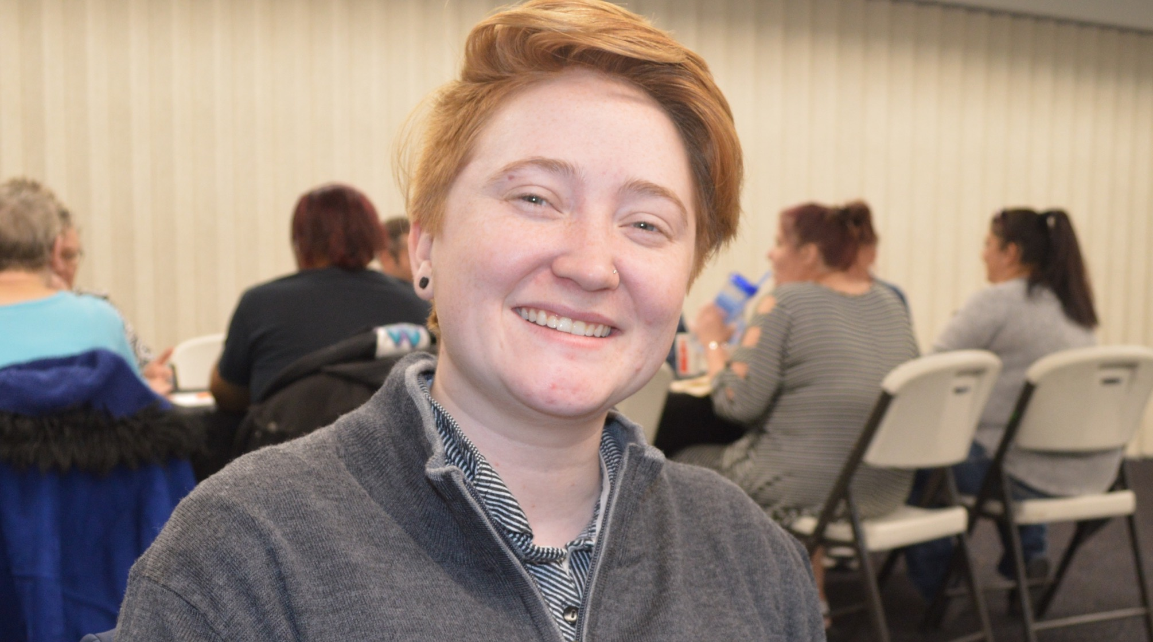
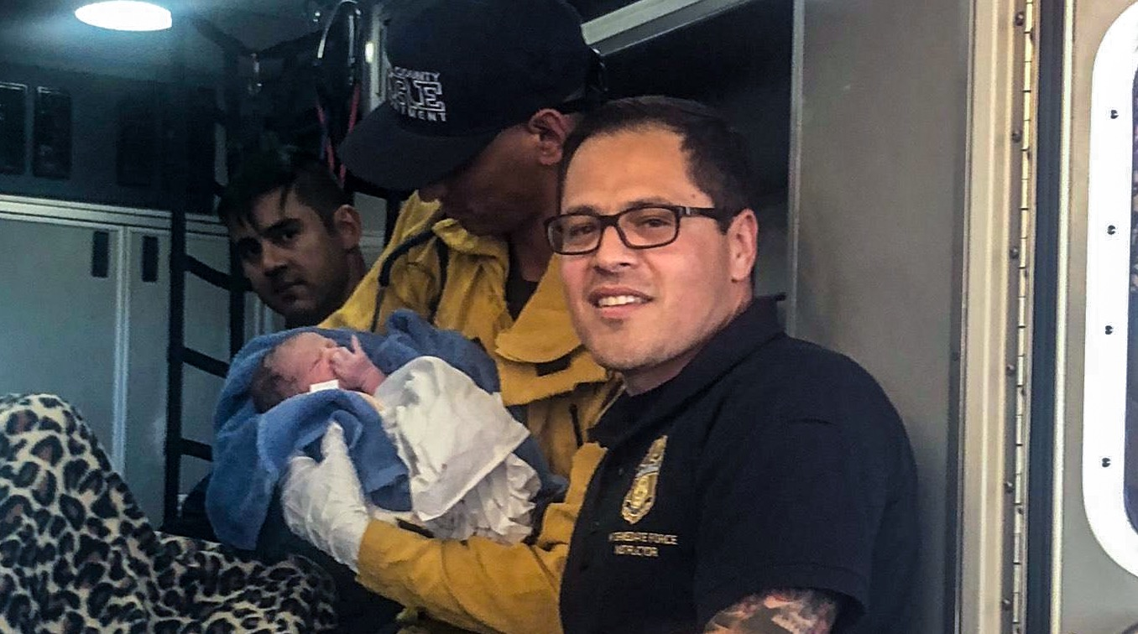
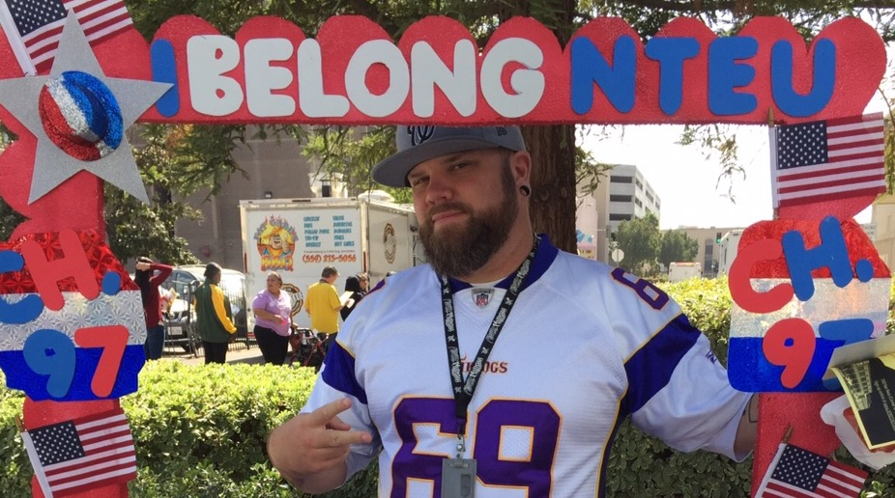
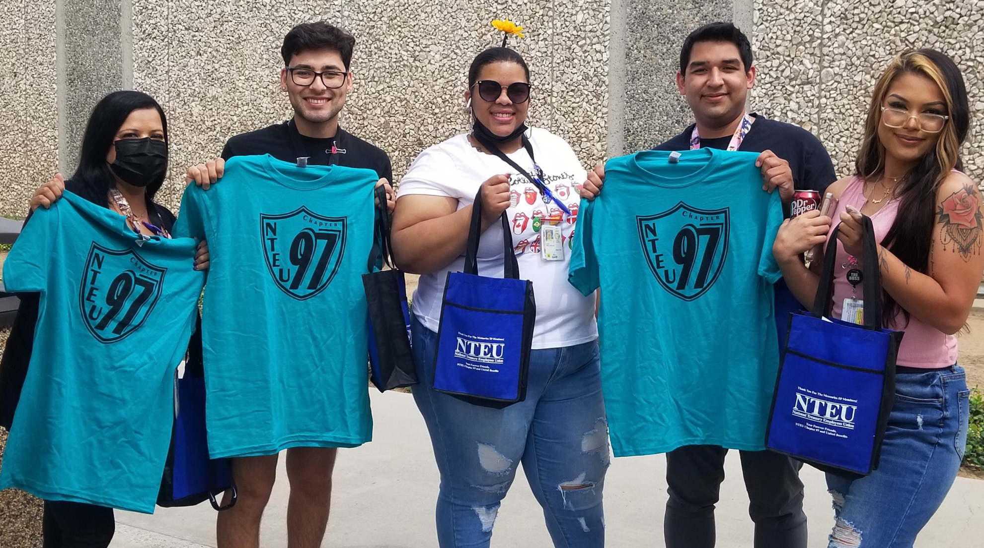
Why should I be an engaged member?
Notes:
Many employees who join the union get inspired to take the next step to getting more active in our chapter.

Slide 15
We are
part of a movement.
We are a community.
We accomplish
more together.
We are powerful and progressive.

Slide 16
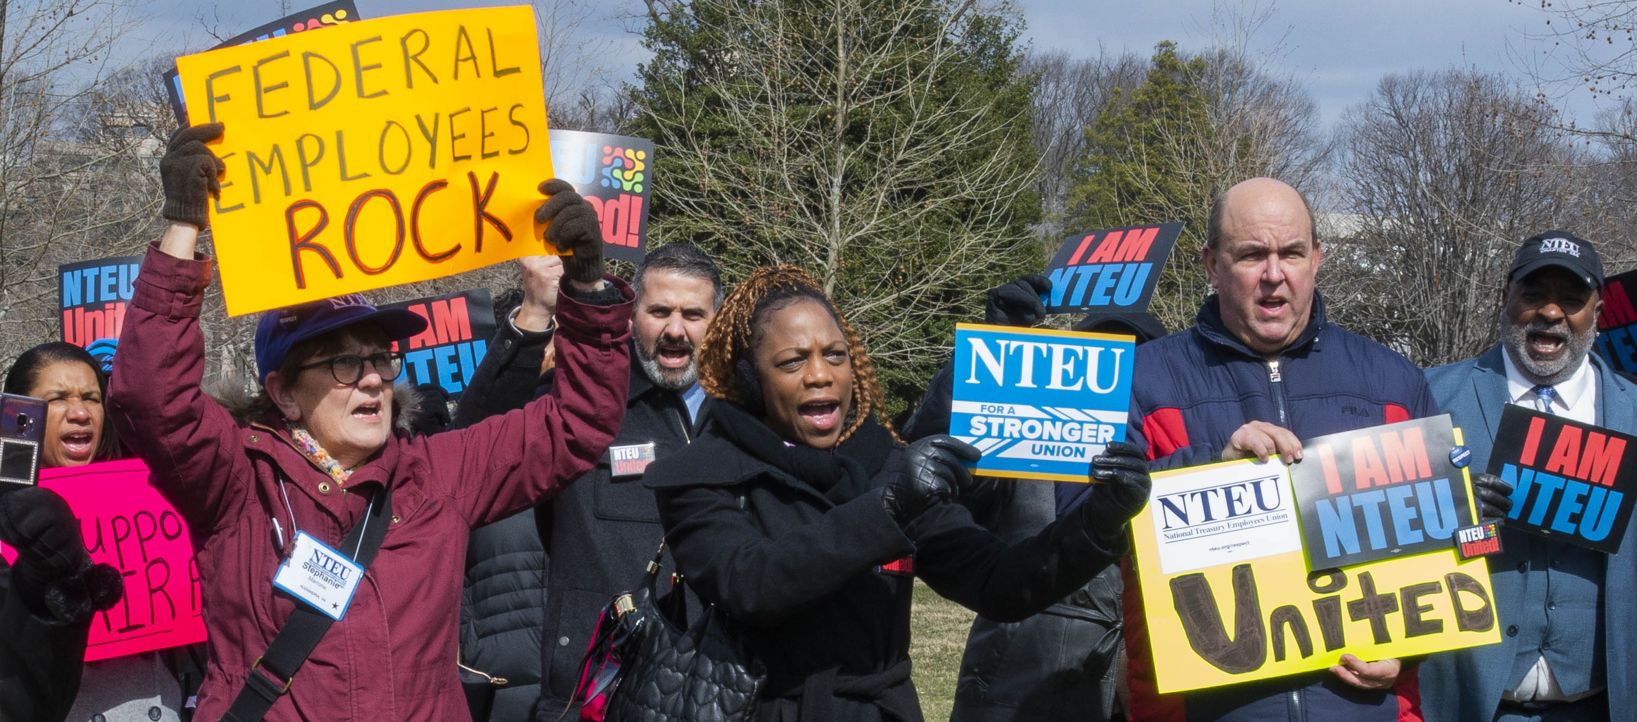
We are part of a movement
Unions started forming in the 1700s out of a common interest of protecting workers.
Notes:
Unions have been in the headlines a lot these days, and they continue to enjoy strong support in the U.S.
According to a Gallup poll, two-thirds of Americans approve of labor unions,

Slide 17
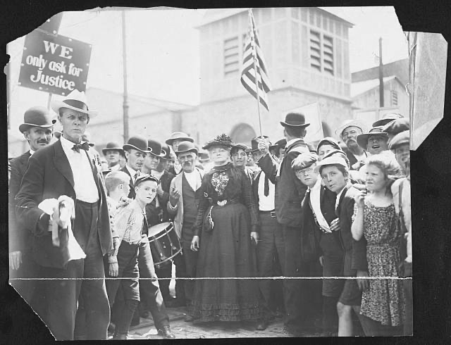
We have unions to thank for the 40-hour week, weekends, a minimum wage, workplace safety standards, improvements to health care and
much more.
Notes:
Unions have a proud history that we continue to build on today.
Workers organized together to demand better treatment, safety and pay during the Industrial Revolution.
Over the decades, organized labor has achieved the minimum wage and maximum working hours, and workplace safety regulations.

Slide 18

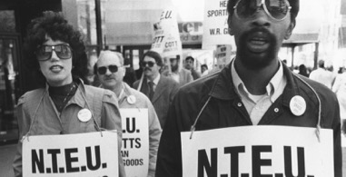
NTEU is your union
Established in 1938 by Internal Revenue collectors in Wisconsin NTEU’s mission is to ensure every federal employee is treated with dignity and respect.
Our values are:
Solidarity
  Fairness
  Equality
  Transparency
  Community
  Pride in Public Service
Notes:
At the Bureau of Internal Revenue in the 1930s, the pay was low, the work dangerous and many had no civil service protections.
Revenue collectors organized in Wisconsin in 1938, forming what would later become NTEU Chapter 1!
Over time, NTEU grew in size, attracted by NTEU's solid representational work and success in winning rights and benefits.

Slide 19
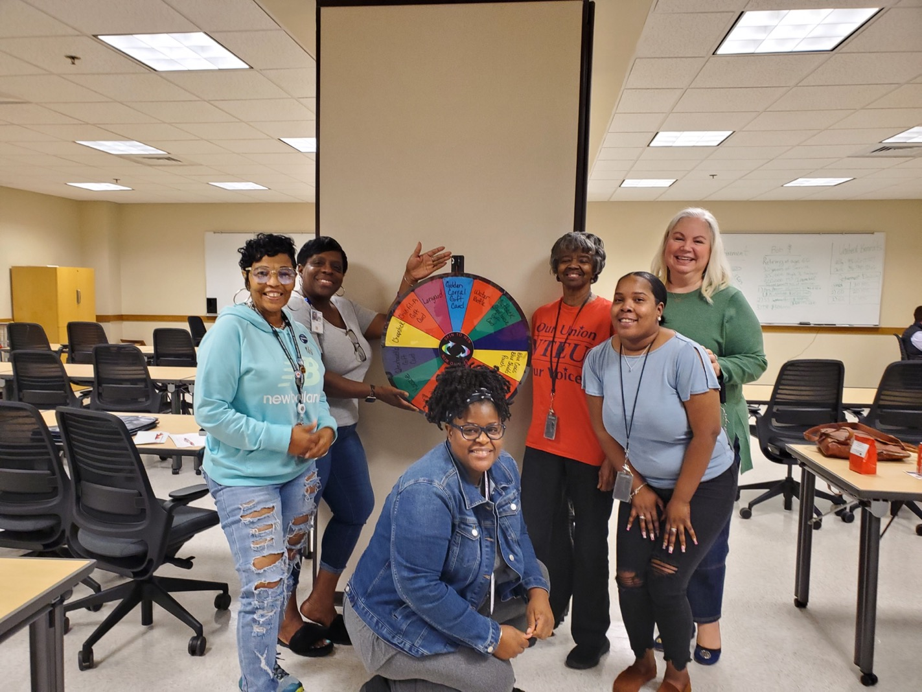
WE ARE A COMMUNITY
NTEU connects you to a larger community of other public servants beyond your team, your division and even your agency.
We work together to make
your work life better.
We give a collective voice to
frontline employees.
Notes:
Throughout the federal government, NTEU represents employees in hundreds of different positions. But we are united in our commitment to public service, our agency missions and improving the federal workplace for employee today and tomorrow.

Slide 20
































NTEU represents employees in 35 Departments and agencies
Notes:
NTEU has grown through the years and represents more than just Treasury! Today, NTEU represents tens of thousands of employees at 35 departments and agencies.

Slide 21
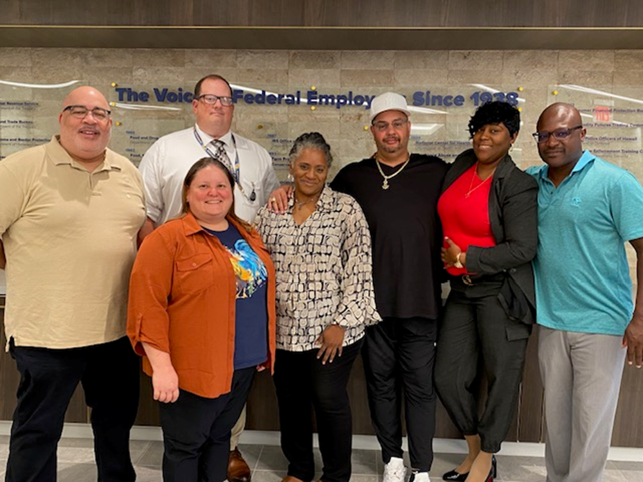
We accomplish more together.
NTEU is a strong union. We take pride in providing the best representation in the federal sector.
NTEU members are represented by their local chapter and NTEU’s National Office.
Notes:
On the national level, NTEU is on the front lines securing higher pay raises, protecting and improving federal benefits, and ensuring employees have meaningful input in workplace decisions. NTEU is led by National President Doreen Greenwald, a former frontline federal employee of 35 years.
In our workplace, your local chapter leaders, supported by experienced staff attorneys, ensure employees receive expert assistance with everything from dealing with a difficult manager to completing FMLA paperwork to getting help with telework denials.

Slide 22

Your Local NTEU Chapter
YOU ARE PART OF
Chapter 000, Chapter Name
YOUR CHAPTER LEADERS ARE
First Last, Title
First Last, Title
First Last, Title
YOUR UNION OFFICE IS LOCATED AT
Location of Union Office
<<< Replace photos with chapter photos
Notes:
[Discuss local chapter wins here]

Slide 23
Chapter WinS
Intentionally left blank for Chapter use.
Outline some of your chapter wins.
Replace photos with chapter photos.
Replace photos with chapter photos >>>
Notes:
[Discuss local chapter wins here]

Slide 24
Through the years,
NTEU has won…
Higher Pay Raises
Paid Parental Leave
Transit Subsidies
Guaranteed Back Pay
in a Shutdown
Millions in Back Pay
Higher Overtime Rates
Flexible Spending Accounts
New Locality Pay Areas
Student Loan Repayment Programs
Improvements to the
Thrift Savings Plan
A Voice in the Political Process
Notes:
These are significant accomplishments that NTEU members secured over the years—accomplishments made possible by employees standing together with a strong unified voice.

Slide 25

We Never stop working.
After we win a benefit, like telework or alternative work schedules, NTEU vigorously protects these benefits from cuts.
And we make sure management follows the contract and respects your rights.
Notes:
Telework has been attacked by some in Congress and has been rolled back in some agencies to pre-pandemic levels. But NTEU contracts protect your right to telework—a right we won—and local leaders like me enforce your contract and your rights.

Slide 26
We have more work to do…

Slide 27
NTEU’s priorities are:
Improving federal pay
Protecting and expanding telework
Securing a paid family leave program
Defending a well-funded and secure retirement system
Ensuring agencies have adequate funding
Protecting union and workplace rights
TOGETHER, we can accomplish all of this.
Notes:
Every year, NTEU members help set our legislative priorities for the year—what NTEU advocates for on Capitol Hill. Here are the issues we have been laser-focused on this year. They impact the lives of every federal employee.
When we band together and amplify each other’s voices, members of Congress take notice.

Slide 28
A tale of two agencies
FOOD AND NUTRITION SERVICE EMPLOYEES WERE REPRESENTED BY NTEU | NATIONAL INSTITUTE OF FOOD AND AGRICULTURE EMPLOYEES WERE NOT REPRESENTED BY NTEU
WHAT HAPPENED WHEN THE AGENCY ENACTED TELEWORK RESTRICTIONS IN JANUARY 2018?
Our contract ensured three telework days a week. | Employees were restricted to one telework day per week.
WHAT HAPPENED WHEN THE AGENCY ANNOUNCED PLANS TO MOVE ITS HEADQUARTERS?
The agency moved less than four miles away, near a Metro station. Employees were involved and informed by their union every step of the way. NTEU negotiated a $90/month parking allowance. | The agency moved from the D.C. area to Kansas City. Between the telework restrictions and move, a significant number of employees quit.
Notes:
Here is a real-life example of the difference a union can make, and how having NTEU representation significantly improves your everyday working life. It can mean the difference between employees who want to stay at their jobs or leave.

Slide 29
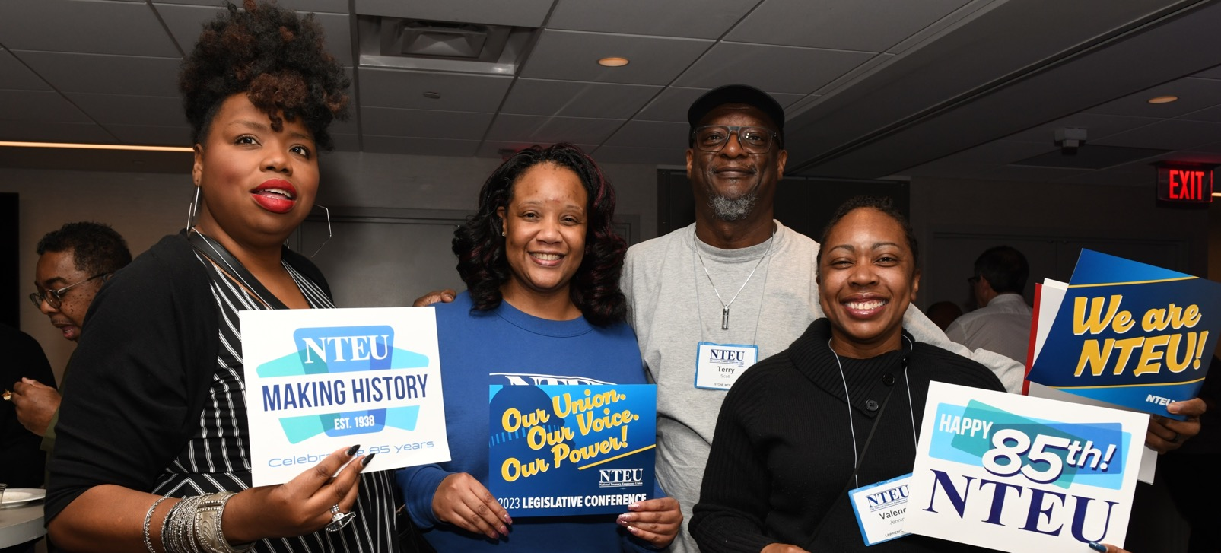
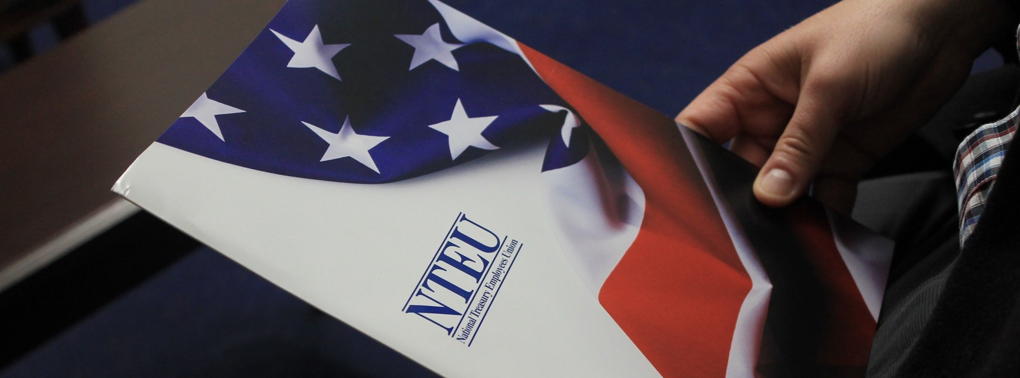
Join NTEU Today!
We are
building a stronger future
for you, your agency
and our country.
NTEU.org/Join
Notes:
Join us in building a stronger future for you, your agency and our country.
Complete an SF-1187 online today! Our one-page form is fully electronic from start to finish and can be completed from your computer, tablet or desktop in just a few minutes.

Slide 30
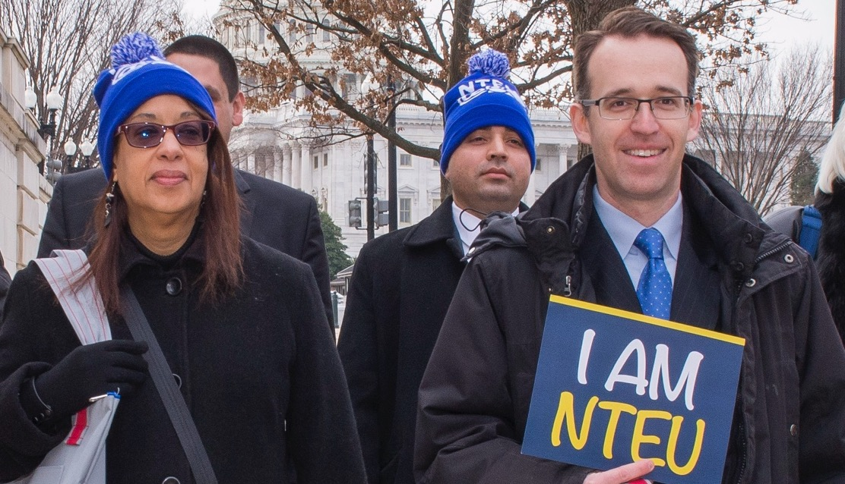
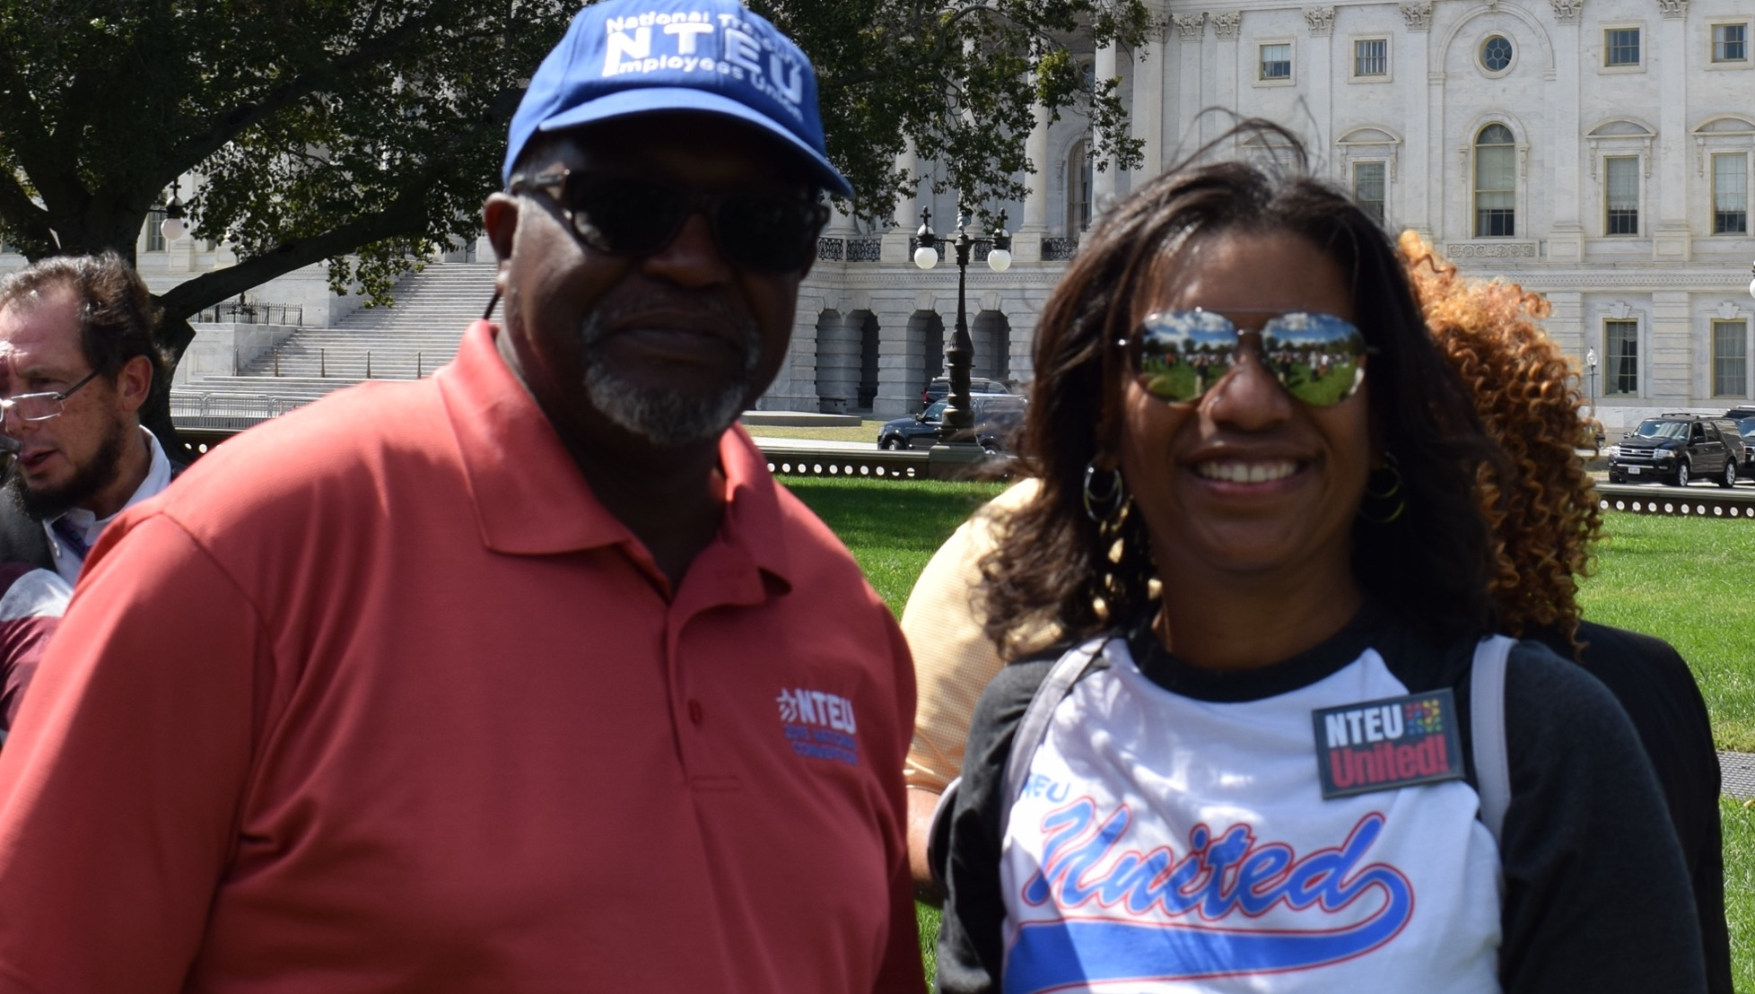
Have a Voice in Your Workplace:
Join as a member, nteu.org/join
Participate in chapter events and
be engaged
Be your own advocate
Know your rights. Make sure you have a copy of your contract
Contact your chapter for help, questions and concerns
Together, we can WIN.
Notes:
Here are five steps to have a greater voice in your workplace and to get educated and empowered.

Slide 31
MISSION: to organize federal employees to work together
to ensure that every federal employee is treated with dignity and respect.
NTEU.org/Join
Notes:
Thank you for your time. We’re here for you if you have questions about our union.

