Slide 1
Take the NTEU Challenge

Slide 2
True or False
NTEU only represents employees at my agency.

Slide 3

False:
NTEU proudly represents federal employees at 35 different federal agencies and offices.

Slide 4
The newest bargaining unit to join our union comes from which agency?
A. Federal Housing Finance Agency
B. The Department of Labor
C. The Justice Department
D. The Department of Education

Slide 5
Answer:
A. FHFA
In August, employees of the Federal Housing Finance Agency overwhelmingly voted for NTEU representation.
Welcome to the union, FHFA employees at Chapter 343!

Slide 6
True or False
When NTEU negotiates new contracts and agreements, our bargaining teams are comprised of only professional negotiators.

Slide 7

False:
NTEU teams are comprised of chapter leaders representing different workplaces, positions, and geographic locations. They bring real-world workplace issues and concerns to the table and ensure the diverse frontline perspective is represented.

Slide 8
Through the power of collective bargaining, NTEU members have negotiated agreements that provide for expanded workplace rights, benefits and programs.
Which president signed an executive order giving federal employees the right to collective bargaining?
A. Jimmy Carter
B. Franklin D. Roosevelt
C. John F. Kennedy
D. Lyndon B. Johnson

Slide 9
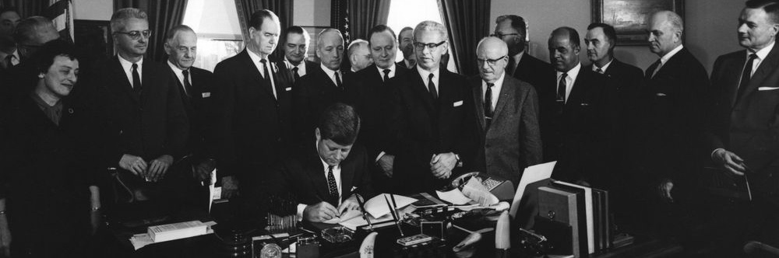
Answer:
C. John F. Kennedy
In 1962, federal employees first obtained the right to
engage in collective bargaining through an executive order
issued by President John F. Kennedy.

Slide 10
True or False
The union only helps employees who have issues with managers or need to file a grievance.

Slide 11


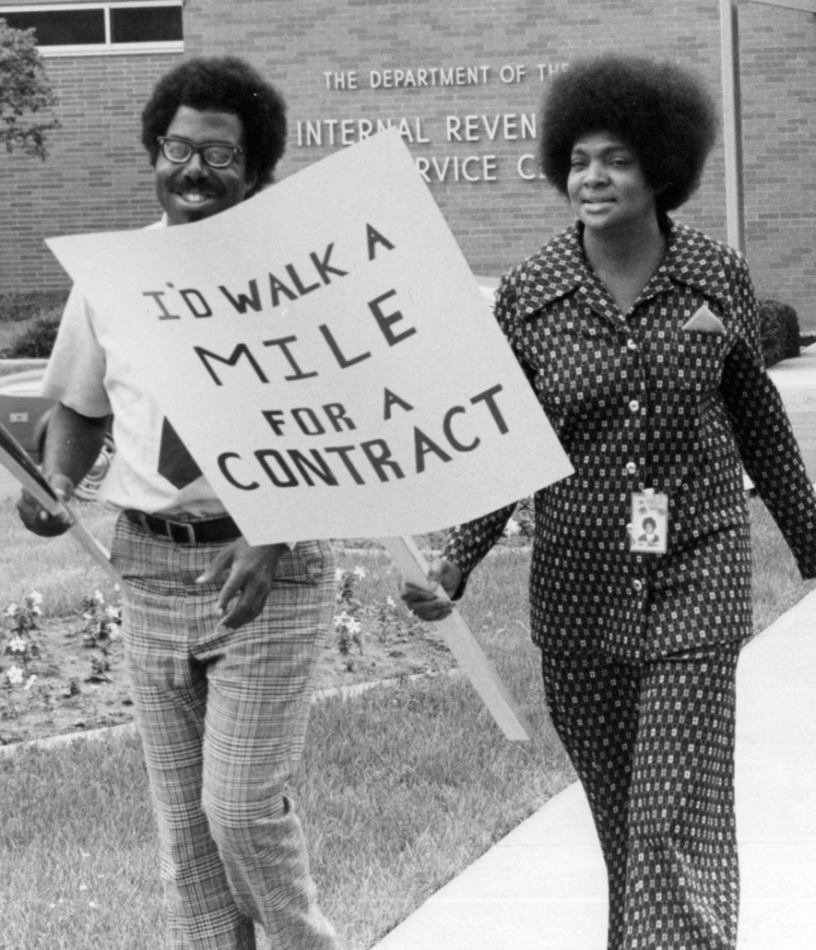
False:
While it’s true that NTEU helps employees if they are treated unfairly or if management violates the contract, your local chapter is a valuable resource at all stages of your career. Stewards are there for you when you have a question, need help filling out paperwork or need counseling in dealing with a manager or workplace issue.

Slide 12
Your contract is the most important document in your working life. It provides for:
​
​A. Workplace programs
B. Benefits and protections
C. Holds management accountable
D. Ensures equal opportunities

Slide 13

Answer:
All the above!
As an NTEU-represented employee, you have benefits, programs and resources well beyond what another federal employee may receive. That’s because we negotiate the most innovative contracts in the federal government.
Doreen P. Greenwald
NTEU National President

Slide 14
NTEU’s first chapter was formed in 1938 in which state?
A. New York
B. California
C. Wisconsin
D. Texas

Slide 15
C. Wisconsin
NTEU’s first charter in 1938 established Chapter 1, representing employees of the Bureau of Internal Revenue in Wisconsin.
Answer:

Slide 16
Final Question!
True or False
NTEU-represented employees touch the lives of every American in meaningful, positive ways.

Slide 17






TRUE:
The list of critical tasks NTEU-represented employees perform for our nation each and every day is very long. Our members do everything from guarding our borders to safeguarding our food, air and water, to supporting research for a global clean energy economy, to collecting the revenue that keeps our country functioning.

Slide 18
Thank you for all that you do!

