Slide 1
NTEU Trivia
Let’s Play!

Slide 2
Question 1
NTEU has been around for a long time. What year was NTEU founded?

Slide 3
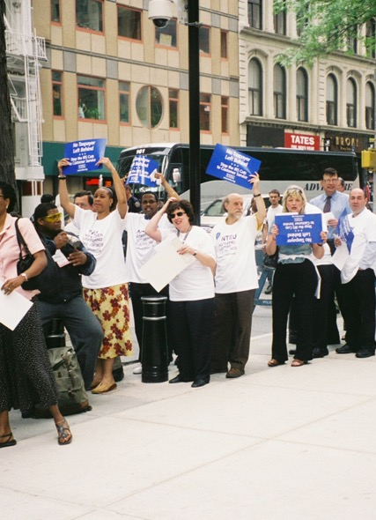
Question 2
Fill in the missing words in NTEU’s mission statement.
To organize federal employees to work together to ensure that every federal employee is treated with ______ and _______.

Slide 4
Question 3
During an election year, federal employees have a lot of political rights. This was not always the case.
In 1994, NTEU won major revisions to what law that broadened your ability to participate in political activities?

Slide 5
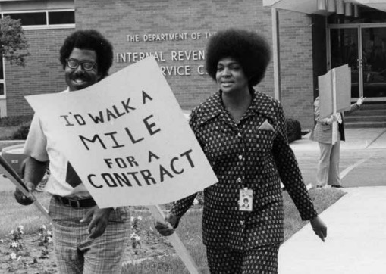
Question 4
Which president signed an executive order giving federal employees the right to collective bargaining?

Slide 6
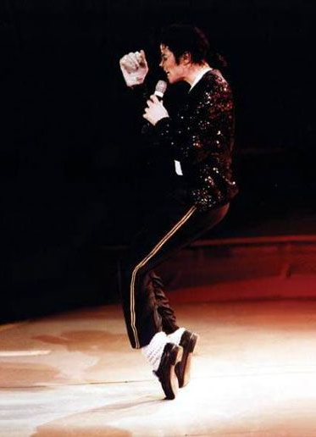
Question 5
In 1982, NTEU won passage of a groundbreaking new workplace option—alternative work schedules.
This gave employees more flexibilities and more time to dance along with a best-selling Michael Jackson album, also released in 1982.
What is the name of the album?

Slide 7
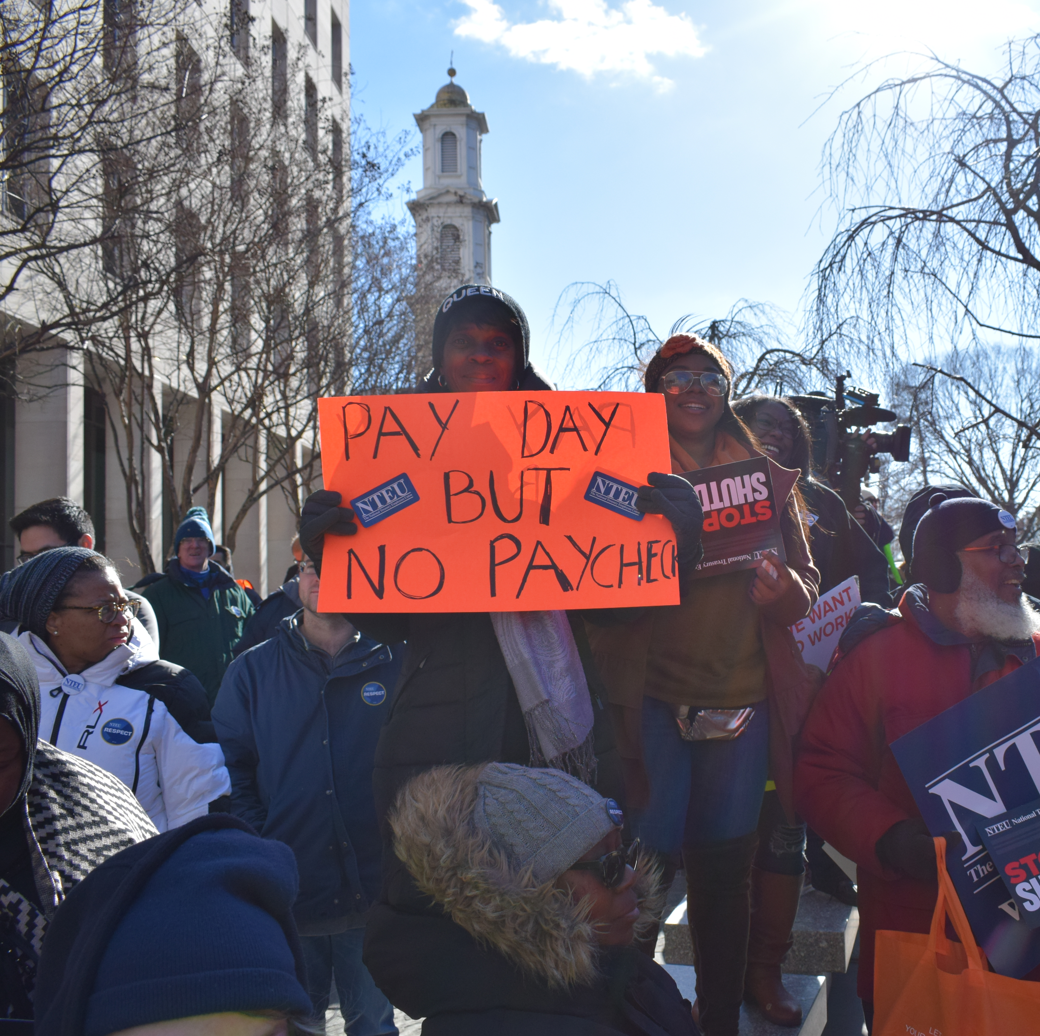
Question 6
During the 35-day government shutdown that ended in January 2019, NTEU achieved a legislative victory with lasting consequences.
A union-supported law was passed ensuring that federal employees would always receive what should another shutdown occur?

Slide 8
Question 7
NTEU keeps growing as word spreads about our top-notch representation. In 2018, employees of the Federal Law Enforcement Training Centers voted for NTEU.
At how many federal agencies does NTEU represent employees?

Slide 9
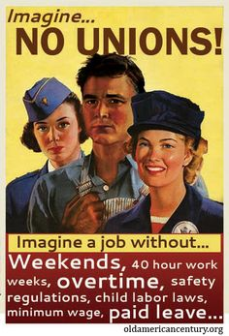
Question 8
Employees represented by NTEU have a powerful set of rights and protections collected into one document.
What is that document?

Slide 10
Question 9
NTEU won $533 million in back pay for federal employees illegally denied raises after suing which president?

Slide 11
Question 10
In October of 2020, a new benefit will be available to federal employees, thanks to NTEU’s work on Capitol Hill.
What is that benefit?

Slide 12
The End?
Not a chance.
NTEU is still going strong

