Slide 1
Happy Labor Recognition Week!

Slide 2
Are YOU up for a challenge?
See how well you know NTEU’s history…

Slide 3
Federal employees’ political voices were freed as NTEU secured major revisions to the Hatch Act in….
41973 4 1994
4 1984 4 2001
Can you guess the year?

Slide 4
1994
NTEU won major reforms
to the Hatch Act in 1994.

Slide 5
NTEU—alone, as other federal unions were opposed—won a new law giving federal employees AWS in…
4 1982 4 1991
4 1987 41998
Can you guess the year?

Slide 6
1982
Since passage of that act, NTEU has negotiated enforceable programs in its contracts.

Slide 7
Binding and enforceable arbitration replaced advisory arbitration, strengthening the rights of employees.
4 1969 4 1982
4 1978 4 1986
Can you guess the year?

Slide 8
1978
Binding arbitration is part of the Civil Service Reform Act of 1978, a key improvement to the original bill.

Slide 9
President John F. Kennedy signed an executive order giving federal employees the right to collective bargaining.
4 1960 4 1962
4 1961 4 1963
Can you guess the year?

Slide 10
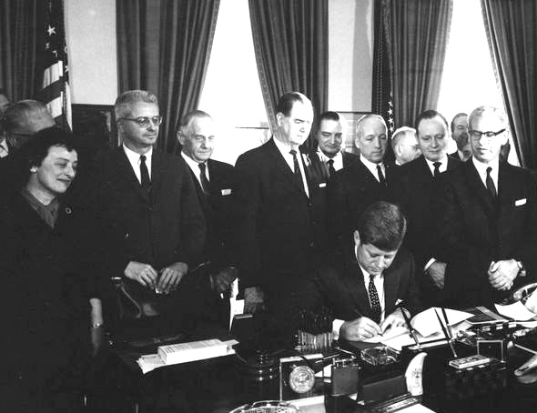
1962

Slide 11
NTEU won millions of dollars in back pay for federal employees.
4 1974 4 2003
4 2002 4 2006
Can you guess the year?

Slide 12
EVERY Year!
NTEU routinely wins back pay for federal employees; the total figure runs into the hundreds of millions of dollars.

Slide 13
NTEU negotiated the first guaranteed performance award agreement in the federal sector.
4 1988 4 1995
4 1991 4 1997
Can you guess the year?

Slide 14
That IRS agreement is now worth nearly $35 million to employees and is a model contract in the federal government.
1995

Slide 15
The Telework Enhancement Act requires federal agencies to establish policies promoting telework.
4 1997 4 2003
4 2010 4 2015
Can you guess the year?

Slide 16
2010
NTEU never stops looking for ways to make programs better for federal employees.

Slide 17
BONUS ROUND
Test your labor history.

Slide 18
The Fair Labor Standards Act of 1938 established which of the following:
4 minimum wage 4 40-hour workweek
4 overtime pay 4 prohibition on child labor

Slide 19
All of Them!
Organized labor pushed for these provisions which were
included in the 1938 law, passed the same year NTEU was founded.
Over the years, NTEU made sure the federal
workplace adopted the FLSA provisions.

Slide 20
It is true…
Labor unions brought you the weekend and so much more.
NTEU is proud to be the most effective labor union
in the federal sector.

Slide 21
NTEU has a rich history that provides us with the experience and expertise to handle challenging times…and we will continue to fight for the dignity and respect for federal employees.
Thanks for playing!

